Slide 1
Praying the promises of God
Notes:
Introduction
The AY department realized that we are living in a time where persons have worries, problems, and sometimes uncertainty about the future. So, we wanted to have a program focused on reassuring us that God through his word has sent us messages of miracles and hope to help you combat even the worst of life’s challenges, a program that reassures us he is still in control. The messages I’m referring to are the many promises he has given us in his Word. Because of God’s promises, we know he loves us, he is with us, he will never leave us, he will fight our battles, heal our diseases, and much more. God’s promises have the power to calm storms, incite miracles, and, best of all, deliver us. So today we’re going to be not looking at the promises of God and how we can claim and pray these precious promises

Slide 2
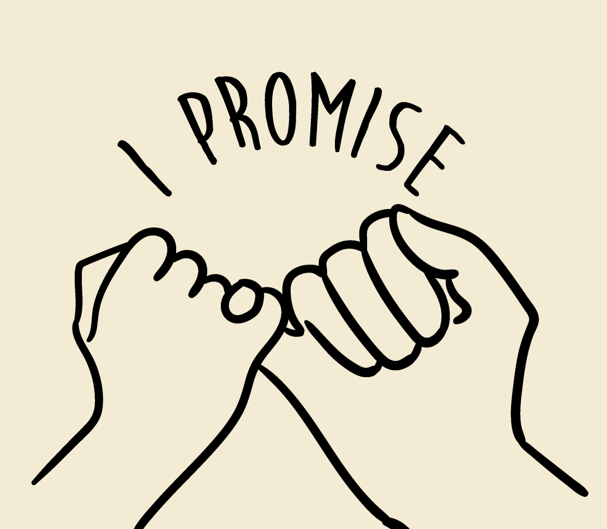
What is a promise?
Promise - a declaration or assurance that one will do something or that a particular thing will happen.
Notes:
Question for your audience:
Why do we need to pray the promises of God?
Everything that God has written or said concerning you must be affected by the power of prayer. You can’t fold your hands across your chest and expect to see all the promises of God come to past in your life. When God speaks a word over you or you want to place reliance over the promises of God as contained in the Scriptures, there is a positive action that is required of you.
The Bible says in the book of James, that faith without works is dead. James 2:17-18 Even so faith, if it hath not works, is dead, being alone. 18 Yea, a man may say, Thou hast faith, and I have works: shew me thy faith without thy works, and I will shew thee my faith by my works. And the reason why we struggle is because we have failed to enforce the promises of God over their lives. These promises that are contained in the Scripture, there is a need for you to pray the promises into reality.
We can use God's promises to receive His blessing; it's like cashing in a spiritual promissory note. We can also use God's promises to praise Him for all He is doing for us. Scriptures can guide our prayers to help us fulfill God's requirements for our lives.

Slide 3
Characteristics of Gods Promises
I Kings 8:56-"Blessed be the Lord, that hath given rest unto his people Israel, according to all that he promised: there hath not failed one word of all his good promise, which he promised by the hand of Moses his servant."
God’s Promises are Unfailing
Notes:
The awesome part of God's promises is that they will never fail and will not go broken. Not one word of God's promises have failed! That is great, because He has promised great things to come.

Slide 4
Characteristics of Gods Promises
Romans 4:20-21-"He staggered not at the promise of God through unbelief; but was strong in faith, giving glory to God; And being fully persuaded that, what he had promised, he was able also to perform."
His Promises Are Assured by Divine Ability
Notes:
Not only are God's promises unfailing, but they are backed by a perfect effort...Divine Ability. God is able to do anything so why wouldn't we totally believe in His promises.

Slide 5
Characteristics of Gods Promises
II Peter 1:4-"Whereby are given unto us exceeding great and precious promises: that by these ye might be partakers of the divine nature, having escaped the corruption that is in the world through lust."
His Promises Are Of Infinite Value
Notes:
First, He saves us, and then he gives us blessings that we often don't deserve. But that isn't it. He doesn't stop at that. He gives us promises that have no bounds.
There is nothing that can stop God from fulfilling a promise. Plain and simple, if He makes a promise then he will come through.

Slide 6
His word will not return void
His word cannot be broken
He cannot lie
Notes:
His word will not return void
“So shall my word be that goeth forth out of my mouth: it shall not return unto me void, but it shall accomplish that which I please, and it shall prosper in the thing whereto I sent it.” - Isaiah 55:11
His word cannot be broken
Man can change at will; circumstances may force him to change and break his word or promise. But not so with God.
“God is not a man, that he should lie, nor a son of man, that he should change his mind. Does he speak and then not act? Does he promise and not fulfill?” (Numbers 23:19).
His Word Cannot be Broken or Altered “My covenant will I not break, nor alter the thing that is gone out of my lips.” - Psalm 89:34
God Cannot Lie
“So God has given both his promise and his oath. These two things are unchangeable because it is impossible for God to lie. Therefore, we who have fled to him for refuge can have great confidence as we hold to the hope that lies before us.” - Hebrews 6:18

Slide 7
Types of Promises
Conditional Promises
Unconditional Promises
Notes:
Ask question to your audience:
What is a conditional promise vs and unconditional promise?

Slide 8
Types of Promises
Unconditional
Never again shall all flesh be cut off by the waters of the flood; never again shall there be a flood to destroy the earth.” Genesis 9:11

Slide 9
Types of Promises
Conditional
Honor your father and mother,” which is the first commandment with promise: “that it may be well with you and you may live long on the earth. Eph 6:2,3

Slide 10
Know His Promises
2 Corinthians 1:20 For as many as are the promises of God, in Him they are yes; therefore also through Him is our Amen to the glory of God through us.
Notes:
By God’s grace, His promises have no expiration date. So how do we cash in? For one, we have to know what those promises are. That means reading His inspired Word regularly. The Word of God is everything; it must come alive in our minds and hearts. It must be seen and heard before it can be believed.
“And ye shall know the truth, and the truth shall make you free.” - John 8:32. It’s the truth you know that will set you free. And what is the truth? The WORD. John 17:17 says, “Sanctify them through thy truth: thy word is truth.” If you are ignorant of the word, there is no way you will be able to apply them in your prayer and manifest them in your life. So the first basic requirement for praying and manifesting the promises of God is to read and know the promises. Then meditate on them and let them sink deep in you.

Slide 11
You Must Go to God in Faith
“And without faith it is impossible to please God because anyone who come to him must believe that he exist and that he rewards those who earnestly seek him” (Hebrews 11:6)
Notes:
“And without faith it is impossible to please God because anyone who come to him must believe that he exist and that he rewards those who earnestly seek him” (Hebrews 11:6)
“This is the confidence we have in approaching God: that if we ask anything according to his will, he hears us. And if we know that he hears us—whatever we ask—we know that we have what we asked of him” (1 John 5:14, 15) It is not enough to pray, you must believe to receive your request. Trust God to make it good- his promises. Prayer is useless without faith, because your faith must be tied to the promise.
The point is that we must believe in the promises of God regarding our needs that we are praying about. And if you are finding it hard to really believe the promises, then just talk to God about the difficulty you’re having.
If you have faith in Gods promises how should that affect your attitude when facing difficult times?
Sometimes we are quick to receive the promises of God and claim them without taking positive actions that will bring those promises into reality. And when we do not do our part, we are quick to heap the blame on God that he is unfaithful. Even if God has promised you that you are going to be a powerful minister of the gospel tomorrow, there is a responsibility that is placed on you to pray the promise of God into reality.

Slide 12
Confess and Forsake your Sins
“But your iniquities have separated between you and your God, and your sins have hid his face from you, that he will not hear” - Isaiah 59:2
Notes:
Sin can, and does, stand in the way between us and our prayers. Ask the Holy Spirit to search you and bring to your knowledge any sin that you need to confess and do something about.

Slide 13
Practice Forgiveness
And when ye stand praying, forgive, if ye have ought against any: that your Father also which is in heaven may forgive you your trespasses. But if ye do not forgive, neither will your Father which is in heaven forgive your trespasses. Mark 11:25-26
Notes:
“And when ye stand praying, forgive, if ye have ought against any: that your Father also which is in heaven may forgive you your trespasses” - Mark 11:23-25.
Unforgiveness works more against us than those we refuse to forgive. Again, we can be real with God on this. If the pain is much we can say, Don’t wait until you feel like forgiving before you forgive offences and hurts against you.
Pray to God and receive His grace to forgive in advance and move on. Without forgiveness, we cannot pray and manifest the promises of God in our lives.

Slide 14
Be Persistent
“And without faith it is impossible to please God because anyone who come to him must believe that he exist and that he rewards those who earnestly seek him” (Hebrews 11:6)
Notes:
Now Jesus was telling the disciples a parable to make the point that at all times they ought to pray and not give up and lose heart, 2 saying, “In a certain city there was a judge who did not fear God and had no respect for man. 3 There was a [desperate] widow in that city and she kept coming to him and saying, ‘Give me justice and legal protection from my adversary.’ 4 For a time he would not; but later he said to himself, ‘Even though I do not fear God nor respect man, 5 yet because this widow continues to bother me, I will give her justice and legal protection; otherwise [a]by continually coming she [will be an intolerable annoyance and she] will wear me out.’” 6 Then the Lord said, “Listen to what the unjust judge says! 7 And will not [our just] God defend and avenge His elect [His chosen ones] who cry out to Him day and night? Will He delay [in providing justice] on their behalf? 8 I tell you that He will defend and avenge them quickly. However, when the Son of Man comes, will He find [this kind of persistent] faith on the earth?” – Luke 18: 1-8

Slide 15
Is God always on time?
2Pe 3:9 The Lord is not slow in keeping his promise, as some understand slowness.
Notes:
If God is never slow concerning his promises, why does he take so slow. His gifts/promises are abstract from his plan.
You can use examples such as Hannah - praying for a son or Job – losing everything to show that despite God moving in his own time we are guaranteed his promises. We must remain faithful and trust him.

Slide 16
What’s Your favorite promise?
Notes:
Allow feedback from your audience to further engaged from their perspective what has been most impactful in their own life.

