Slide 1
#relationshipgoals
Presented by Berea and Breath of Life Youth Department
Notes:
Introduction:
So, I want us to have some context on what the #relationship goal trend is. If you do a search for # relationship goals on social media you’ll see pictures couples posing at maybe on the beach or a gorgeous vacation spot with a nice view, or cute couples kissing or cuddled up, a boyfriend-girlfriend pair holding balloons in the park and just giving the impression that their relationship has never been anything but pure happiness. And when people repost these pictures with the caption hashtag relationship goals. And when they do this they’re saying, “I want a relationship like that!” And while there’s nothing inherently wrong with that, as young Adventist Christians we don’t want our influence or guidance for our relationships to be based on social media, but we want it to be a biblical one. So today we’re going to talk a little bit about relationships and goals we should have but we’re first going to lay some foundational concepts.
This is an introduction to the whole program feel free to use it or create your own.

Slide 2
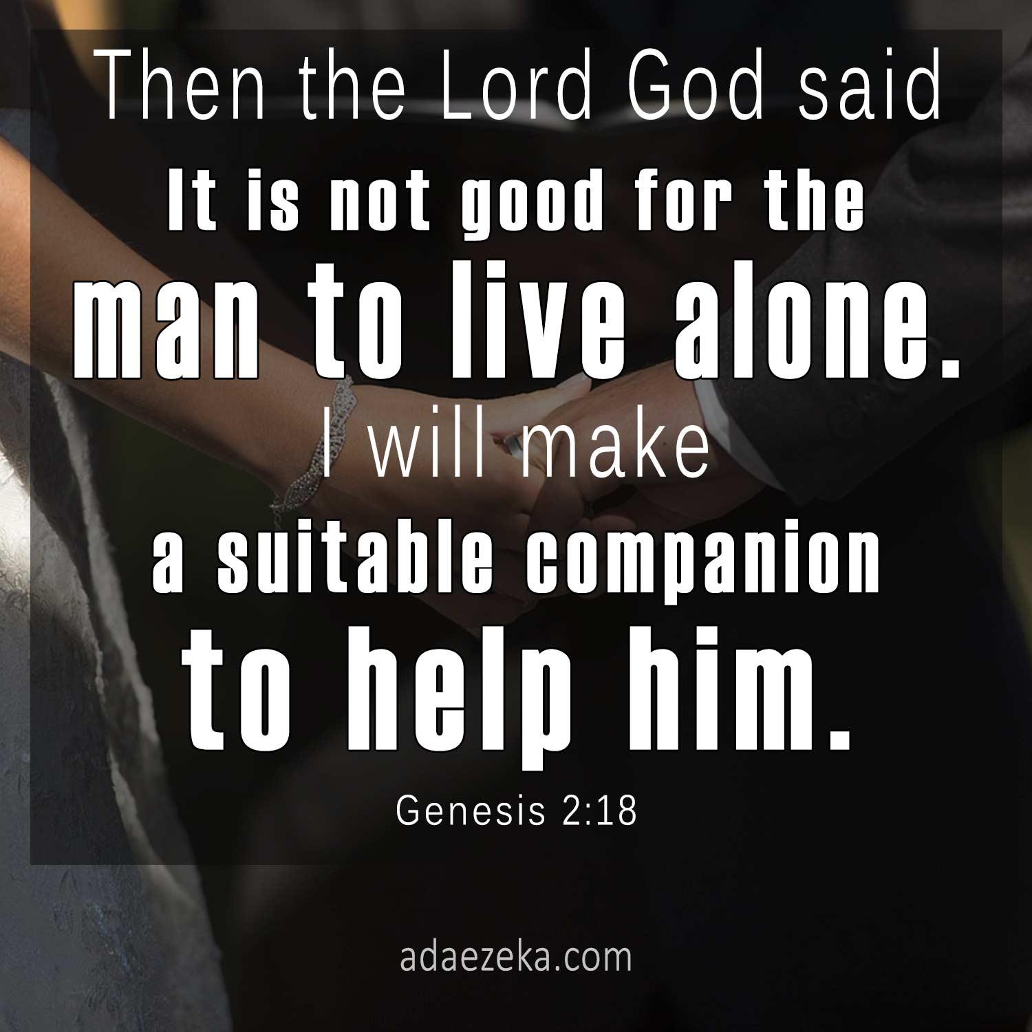
It is not Good (Genesis 2:18)
Notes:
So, we’re going to start by looking at our scripture text for today.
In the beginning when God was creating, at the end of each creation he declared it was good. But pretty soon God said for the first time, “It’s not good.” It’s not that God had messed up—He never messes up. Something was missing. “The LORD God said, ‘It is not good for the man to be alone’ ” (Genesis 2:18).
Relationships were first instituted by God the Father. In Genesis 2, God brought forth the second most important relationship someone can have. God intended from the dawn of time that man not walk alone. It was also the intention of God to make a helper suitable for Adam, one who would truly complement him. God made us relational creatures so if we want to understand how to have a successful relation we must look to the creator and what biblical guidelines there are for us to follow.
What do you think is your most important relationship?
Here are some scripture passages to help.
1 Peter 4:8
1 Thessalonians 5:11
Song of Solomon 8:6-7
Song of Solomon 4:9

Slide 3
The most important relationship
Have consistent conversation (Prayer)
Spend time in his word
Obedience
Helping Others
Notes:
What are some of the things that we do when we are trying to get to know someone?
How do we get to know God?
-Prayer
-Make sure we listen not only talk
-Spend time in his word
When we’re getting to know someone, we may do little thoughtful things to demonstrate or show how you feel inside…. Is there something we can do to show that we love God?
Then shall he answer them, saying, Verily I say unto you, Inasmuch as ye did it not to one of the least of these, ye did it not to me. – Matthew 25:45
“If you love me, obey my commandments.” – John 14:15 NLT
We can’t be successful in any other relationship without a relationship with God…friendship, girlfriend/boyfriend, family relationships, marital relationships, we can't be successful without God, because God is the relationship giver, he created us

Slide 4
Before the relationship
Examine your motives
Make sure your faith is on the same page
Find yourself before finding someone else
Notes:
When should I date?
-no right or wrong answer to this, highly subjective but I’d like to share some things that I think you should consider before you get into a relationship
As a young Christian (or wherever you are on your spiritual journey) what are some things that you should consider before you get into a relationship?
Motives
First, you really think about the "why" behind pursuing this relationship.
So, if someone asks you why you want to be in a relationship and you’re giving answers like:
-I’ve been single long enough and I think its time
-Everyone else is in one
While having someone to spend time with fills the need for emotional fulfillment and socialization, in everything a Christian should consider how to best honor God with everything, including their relationships.
Here are some ways we can honor God in our relationships:
Faith
“Do not be yoked together with unbelievers. For what do righteousness and wickedness have in common? Or what fellowship can light have with darkness?” 2 Corinthians 6:14
You should desire to date someone with the same beliefs and someone who will draw yourself closer to God, someone who will help you and someone you will help in your Christian walk.
Purpose
Trust in the Lord with all thine heart; and lean not unto thine own understanding. In all thy ways acknowledge him, and he shall direct thy paths. Proverbs 3:5-6
A lot of times we are so caught up finding someone else that we forgot to find ourselves, find our purpose and have self development. Not only in a spiritual sense but also career wise or any other aspect of your life.
So, Adam not only had relationship before he had a person; he also had a purpose before he had a person. God gave him work to do before He gave him a wife. (And by the way, this is not just about men. Ruth was working in the field when she met Boaz.) When planning to create Eve for Adam, God said, “I will make a helper who is just right for him” (Genesis 2:18). Eve was a partner who helped. One big thing was that she supported him in doing his God-given job. She helped him fulfill his purpose. See, people are so often trying to get a person without first understanding their own purpose—or at least without taking it into account. But a close relationship is going to have a huge impact on how well you can fulfill your purpose.
You want to date someone who will help you to fulfill the purpose for which God put you on this earth instead of getting in the way of that. (And of course, you need to be the kind of person who does the same thing too.)
So, lets look at some relationship goals that I think would be ideal. Not limited list, but ones I decided to focus on.
Feel free to add in other areas you feel that would be helpful within your own context.

Slide 5
#1 - Dating is not the destination
Dating without the intent of getting married is like going to the grocery store with no money. You either leave unsatisfied or you take something that isn’t yours.
Notes:
This dating thing is not supposed to be the place where we stay. It’s supposed to be the place that takes us to marriage. It’s supposed to take us to covenant of marriage. Date with purpose.
(Video) If you have a video that portrays the same point feel free to add one to help bring the point home.
Main Goal:
This should be our goal when dating, The primary reason for marriage is significant to God because it is part of His ordained plan to provide the world with a picture of His love for men and women. Marriage becomes the means for married couples to demonstrate their love for God. This type of marriage covenant was ordained by God to provide believers with a picture of Christ’s love and relationship to His church (Ephesians 5:22-33; Revelation 21:2, 9).
Secondary purpose of marriage is:
Companionship. The affection, love, and true companionship which grow out of a oneness of spirit as each partner models Christ’s unconditional love (Amos 3:3).
Enjoyment. The physical relationship reflects the loyalty and affection shared among marriage partners who have become “one flesh” (Hebrews 13:4).
Fruitfulness. The blessing of children in a marriage relationship allows that relationship to reproduce itself physically. It is an example of the “oneness” that results in a marriage (Genesis 1:28; 1 Peter 3:7).
This should be your mindset when you decide to date.

Slide 6
#2 -R-E-S-P-E-C-T, find out what it means to me
Spiritual Boundaries
Continue to let Jesus be your true love.
Physical Boundaries
Not how far is too far but how pure can we be?
Notes:
Boundaries for safety reasons (not prison)
You Respect One Another’s Boundaries Everyone has boundaries before they’re married. Whether they are physical boundaries, emotional or spiritual. And if you don’t have any of these boundaries then you should really pray about whether or not God wants to to establish them ( I can assure you He will).
Spiritual boundaries Spiritual boundaries are how we protect the health of our relationship with God. You know that you need alone time with Him and a bigger dedication to your relationship with Him than with anyone else. If the other person is dominating your mind and heart your relationship with God will suffer. Continue to let Jesus be your true love. Tell this to your boyfriend/girlfriend. Make sure they understand how much you need the Lord and hopefully you both will help each other pursue Christ above one another.
By respecting these boundaries, you are putting each other first above yourself and learning to love like Christ!
Physical boundaries
For those of us who have been in relationships before how did you go about setting your physical boundaries?
Physical intimacy or sex isn’t a bad thing, God created sex, it was a gift and everything that God created was good. But if it is not used in the container that it was intended to be used in it can be destructive for us (Water example) When water is properly contained and channeled, it can turn electrical turbines and provide light and power for an entire city. Water is essential for all life and growth. What is water when its full power is uncontained and on the loose? Hurricanes, floods. It’s destruction. Or it leaks into where it’s not supposed to be and causes rust, mildew, and rot. What does it look like when we’re having sex outside marriage? It looks like destruction. It can cause, Broken hearts. Divorce. Single-parent homes. Disease. Abuse. Inability to trust. And it is against Gods will for our lives and spiritually destructive.
1 Thessalonians 4:3-5 we read, “It is God’s will that you should be sanctified: that you should avoid sexual immorality; that each of you should learn to control your own body in a way that is holy and honorable, not in passionate lust like the pagans, who do not know God.”
“But I discipline my body and keep it under control, lest after preaching to others I myself should be disqualified.” (1 Corinthians 9:27)
Really seek the Lord on this. Search His word for answers and talk to your parents and spiritual leaders about how to establish these boundaries and how to keep them. Not going to list them but think about what is it that may lead me to be sexually impure.

Slide 7
#3 - Mission Minded
Grow in Christ together as you work towards the mission:
Pray together
Study the word together
Get involved in ministry
Notes:
What are some things we can do together as Christian couples to grow in Christ?
Allow your audience to add to the list to help foster interaction.

Slide 8
#4 -Can you hear me now?-Communication
James 1:19 - So then, my beloved brethren, let every man be swift to hear, slow to speak, slow to wrath
Notes:
Any successful relationship needs good communication.
James 1:19 So then, my beloved brethren, let every man be swift to hear, slow to speak, slow to wrath...Many of the communication pitfalls that wreck relationships come from violating these three keys. We tend to be slow to listen but quick to speak our minds, and in the resulting confusion and selfishness we are very quick to get our feelings hurt and to get angry.
What happens if we are quick to speak instead of quick to hear?
Proverbs 18:13 He who answers a matter before he hears it, it is folly and shame to him. – You should take time to understand the other person.

Slide 9
#4 - Can you hear me now?-Communication
Colossians 4:6-Let your speech always be with grace, seasoned with salt, that you may know how you ought to answer each one.
Notes:
God wants us to choose our words wisely. Blessings and praiseworthy information should predominate our conversations. Think before you speak, don’t speak when you’re emotional.
Ask your audience what they think about the text and what inspiration do they get from it.

Slide 10
#4 -Can you hear me now?-Communication
Proverbs 15:1-2 A soft answer turns away wrath, but a harsh word stirs up anger. The tongue of the wise uses knowledge rightly, but the mouth of fools pours forth foolishness.
Proverbs 25:11-12 A word fitly spoken is like apples of gold in settings of silver. Like an earring of gold and an ornament of fine gold is a wise rebuker to an obedient ear.
Notes:
Any successful relationship needs good communication.
Tone is important - When we speak softly, kindly, wisely, truthfully and with love, we can defuse negative feelings and promote positive relationships.

Slide 11
#5 - Quality Time
Pool
Cook
Archery
Dinners
Exercise
Comedy Shows
Paint and Sip
Bowling
Nature Walks
Water sports
Plays
Movies
Notes:
So, in order for any relationship to grow and flourish you should spend time together. And for a young Christian couple who is dating its no different, so what are some examples of wholesome activities that you can do together?

Slide 12
Guidelines for your Quality Time
Have quality for yourself
Avoid spending time late at night or alone
Know what you’re doing when you have a date
Have an appropriate ending time
Notes:
Help your audience know that self care is important. Finding time for yourself is important as well.
Ask your audience what do they do to help with self care?

Slide 13
$Cha-ching$ Financial goals for your relationship?
Notes:
Ask to your audience “Should you make financial investments as a dating couple?”

Slide 14
What part do we play?
Have the right attitude
Ensure that they are involved and being mentored
Provide healthy social events
Be willing to have open candid conversations
Notes:
It would be helpful to get those who are older and more experience to ask them how can they help with providing help for the younger generation to better navigate relationships.
Address some misconception that you maybe experiencing within your context for example: young people shouldn’t share their emotions.

Slide 15
Notes:
Allow time for questions and answers from your audience they may have topics or concerns you haven’t mention in the presentation.

