Slide 1
Berea and Breath of Life Youth Department presents:
Notes:
Introduction
In today's society, when we’re thinking about names for a child, what are some of the things that inspires us? How to most people go about choosing a name for their child? What are some of the things that we do, or inspire us decide on name?
-Baby books
-Name them after a family member
-Biblical name
-Take a part of the parents’ name
-Favorite character from a book or movie
Do you think naming a child was important in Biblical times?
Idea
A great way to have your young people involve is to give them each an opportunity to visual depict what does it mean for Jesus to be either the vine, the door or the light of the world.

Slide 2
Importance of a Name
1) Names in the Bible can signify origin.
Genesis 2:7 - And the LORD God formed man of the dust of the ground, and breathed into his nostrils the breath of life; and man became a living soul
Adam derives from the Hebrew noun adamah meaning "the ground" or "earth"
Notes:
What's some biblical name you can think to add to share with your audience ?

Slide 3
Importance of a Name
2) Names in the Bible can signify purpose.
Matthew 1:21- And she shall bring forth a son, and thou shalt call his name JESUS: for he shall save his people from their sins.
The name “Jesus” means “savior” and “deliverer.”
Notes:
What does the name Ellen mean? Her testimonies were a lesser light.

Slide 4
Importance of a Name
3) Names in the Bible can describe a person’s characteristics.
Revelation 12:9 And the great dragon was cast out, that old serpent, called the Devil, and Satan, which deceiveth the whole world: he was cast out into the earth, and his angels were cast out with him.
Satan means adversary, one who opposes another

Slide 5
Importance of a Name
4) Names in the Bible can describe a person’s circumstances/parents’ reaction
Genesis 21:2-3 For Sarah conceived, and bare Abraham a son in his old age, at the set time of which God had spoken to him. And Abraham called the name of his son that was born unto him, whom Sarah bare to him, Isaac.
Isaac means laughter.
Notes:
The couple named their son Isaac, as the Lord had instructed. The name Isaac means laughter. Sarah said, “God hath made me to laugh, so that all that hear will laugh with me.” She must have thought about how she laughed at the Lord’s words that day when she was eavesdropping. Sarah laughed then in disbelief.

Slide 6
Importance of a Name
5) Indicate a new beginning or new direction in a person’s life.
Genesis 17:5 “No longer shall your name be called Abram, but your name shall be Abraham; for I have made you a father of many nations.”
Abram, means “exalted father” and Abraham, means “father of a multitude”
Notes:
God changed his name to Abraham to represent what would be done through him because of God’s promises.
His original name, Abram, means “exalted father” in Hebrew. His new name, Abraham, means “father of a multitude” (Brown-Driver-Briggs Hebrew Lexicon).
Abraham’s name now represented how he was being used by God: as the beginning of a nation through whom God would work.

Slide 7
Name Change
Notes:
All four of these Hebrew names had meanings connected to faith in God. But upon arrival in Babylon, their names were changed: “The chief official [of Babylon] gave them new names: to Daniel, the name Belteshazzar; to Hananiah, Shadrach; to Mishael, Meshach; and to Azariah, Abednego” (Daniel 1:7). The boys’ names were changed as a way of encouraging them to forget the God and their belief of their homeland and become conformed to the ways and gods of Babylon. It was a forced assimilation; Nebuchadnezzar wanted Daniel and his friends to “conform to the pattern of this world” (Romans 12:2), and a name change was one step toward that goal.
Assigning new names was a common court practice in the ancient world. Its blatant intention was to change the entire identity of the bearer until the life matched the title.

Slide 8
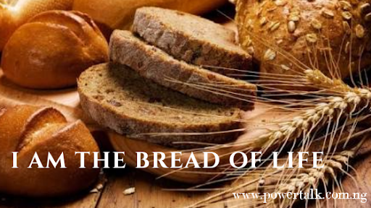
Jesus the Bread of Life – Insert Name
Notes:
Assign a youth to present on what it means to them that Jesus is the bread of life. Insert the name of the presenter on the slide.
Tell your audience about the story of Jesus feeding the five thousand and then ask the following question.
Jesus just performed the miracle of feeding the five thousand (background)
So, the question is, what are you feeding on? What do you try sustain yourself with? If you are a born-again Christian, then you are a heavenly person. And a heavenly person needs to be sustained by heavenly things! God gives us many things to enjoy on this planet but without Him they ultimately become meaningless. We hunger for spiritual things and look to Christ and His word for spiritual nourishment.

Slide 9
Jesus the True Vine – Insert Name
Notes:
Assign a youth to present on what it means to them that Jesus is the True Vine. Insert the name of the presenter on the slide.
The Lord compared us to the branches and compared Himself to the vine. Our relationship with the Lord is like the relationship between vine branches and the vine. Away from the vine, the branches will lose the supply of life and get withered and then die. Only by constantly living before God, reading His words and having a proper relationship with Him, can we be watered and fed by the Holy Spirit and bear the fruit of life. The branches will wither if they are away from the vine.

Slide 10
The Alpha and Omega – Insert Name
Notes:
Assign a youth to present on what it means to them that Jesus is the Alpha and Omega. Insert the name of the presenter on the slide.
One of the meanings of Jesus being the “Alpha and Omega” is that He was at the beginning of all things and will be at the close. It is equivalent to saying He always existed and always will exist.

Slide 11
Jesus the Light of the World – Insert Name
Notes:
Assign a youth to present on what it means to them that Jesus is the Light of the world. Insert the name of the presenter on the slide.
light has many functions that makes it a good symbol for Jesus. Light helps us see things. Jesus gives us the truth and spiritual vision. Light guides us as we travel. Jesus guides us safely through life to our heavenly home. Light promotes growth and life. Jesus brings us everlasting life. Light warms and comforts. Jesus welcomes us and calms us. Light dispels darkness. Darkness represents evil and Jesus pierces the darkness of sin and death and conquers them. All the darkness in the world cannot put out one candle flame. Jesus cannot be overcome by evil.

Slide 12
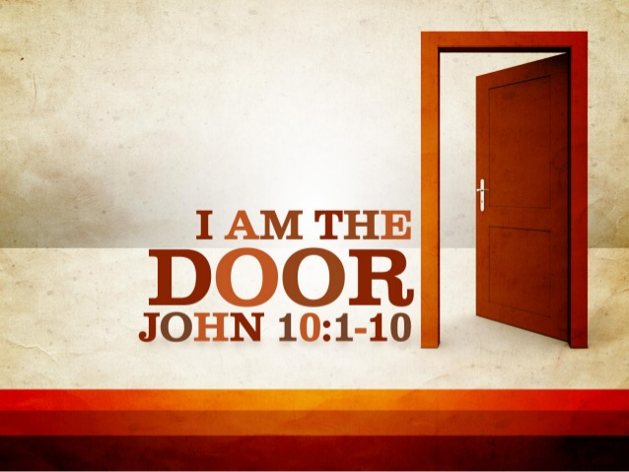
I am the Door – Insert Name
Notes:
Assign a youth to present on what it means to them that Jesus is a door. Insert the name of the presenter on the slide.
When Jesus says, “I am the door,” He is reiterating the fact that only through Him is salvation possible.

Slide 13
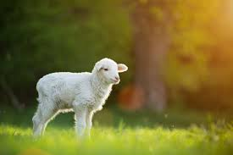
Jesus the Lamb– [Insert Name]
Notes:
Assign a youth to present on what it means to them that Jesus is the lamb of God. Insert the name of the presenter. on the slide

Slide 14
Jesus the Lily of the Valley – Insert Name
Notes:
Assign a youth to present on what it means to them that Jesus is the Lily of the Valley. Insert the name of the presenter on the slide.
Scientists who have studied the plant, the Lily of the Valley, found that it has a substance Convallatoxin. This substance can be used for acute and chronic heart failure. It is mostly administered because it strengthens the heartbeat, while also slowing and regulating the heart rate. I think that it is more than a coincidence that Lily of the Valley produces a medicine that is good for your heart health.
We have mentioned that lilies can grow in deserts and extremely high and cold places. The environment in which you live does not determine whether or not you will bloom, but the person you are inside determines that. Better yet, the God who is inside you (if you are a Christian), can bloom in any environment. You make not like to hear this, but I want you to know that you can have a lot of garbage thrown at you and still be a beautiful fragrance of Christ. In the worst of places, you can be an oasis of refreshing.

Slide 15
What’s your favorite name?
Notes:
The word “rock” is equated with the idea of strength. Rock was used to build walls, fortresses, and towers in Bible times. God is our source of strength in times of distress and danger.
God is also our refuge. Like Moses, we can hide in the cleft of “the Rock.” God will care for us.
“Rock” also typifies something about the nature of God. He is solid as a rock. He is unchangeable in nature — immutable. Moses had this in mind when he spoke of God’s ways and justice (Deut. 32:4).
The “rock” symbolism continues in the New Testament with reference to Christ. He is the foundation, the chief-corner stone. He is the rock of offense to those who reject Him, but the spiritual rock for those who obey Him (Eph. 2:20; Rom. 9:33; 1 Pet. 2:8; 1 Cor. 10:4).
Will your anchor hold in the storms of life, When the clouds unfold their wings of strife? When the strong tides lift, and the cables strain, Will your anchor drift or firm remain? We have an anchor that keeps the soul Stedfast and sure while the billows roll, Fastened to the Rock which cannot move,
Grounded firm and deep in the Savior’s love.

Slide 16
What else do we know about the name of Jesus?
Wherefore God also hath highly exalted him, and given him a name which is above every name: That at the name of Jesus every knee should bow, of things in heaven, and things in earth, and things under the earth; And that every tongue should confess that Jesus Christ is Lord, to the glory of God the Father” (Philippians 2:9–11).
A name of authority and power. His name should be respected.
Notes:
Holy name and should be used wit respect.

Slide 17
Name Dropping
The act of talking about famous or important people that you have met, often pretending that you know them better than you really do, in order to appear more important and special
Notes:
Believe it or not, some professed Christians have used the name of God in the same manner. Acts 19:13–17 tells the story of the seven sons of Sceva, who decided to invoke the name of Christ to cast out demons. Apparently, these itinerant Jewish exorcists saw Paul successfully evict devils using the name of Jesus. They evidently thought, “Hey, Paul’s really good at this! Maybe we should adjust our means of casting out devils by using the name he uses!” At their next opportunity, they threatened a demon that had possessed a man, “We adjure you by Jesus whom Paul preacheth.” The Bible says that “the evil spirit answered and said, ‘Jesus I know, and Paul I know; but who are ye?’ And the man in whom the evil spirit was leaped on them, and overcame them, and prevailed against them, so that they fled out of that house naked and wounded.” Those young Jewish exorcists tried “name dropping” with the devil. They knew the name of Jesus, and they even knew how to pronounce it. They just didn’t know Him as their Lord! And unfortunately for them, even devils can recognize this kind of shallowness. Do you know God? His name, in whatever form—whether Elohim or El Shaddei, is not some enchanted word that must be pronounced correctly, as if casting a spell. His name is a revelation of His character. Paul understood God’s character and could cast out demons by the name of Jesus. The demons obeyed because of Paul’s faith and the authority and the power of Christ’s name. “[Paul] turned and said to the spirit, ‘I command you in the name of Jesus Christ to come out of her.’ And he came out that very hour” (Acts 16:18 NKJV).
A form of godliness but denying the power

Slide 18
What does it mean to take the name of the Lord in vain?
To blaspheme or speak irreverently
To take His name unto yourself and say that you are a child of God—but then live like the world.
Notes:
Vain – emptiness, nothingness, worthlessness : speaking the name of God in a way that empties him of his significance.
We often think of this commandment as primarily condemning profanity (not to blaspheme or cruse the name of God) , and it surely does, but that is the least of its meanings.
Is it wrong to use “oh my god”?
To take the name of the Lord in vain means to take His name unto yourself and say that you are a child of God—but then live like the world.
When we become Christians, we take the name of Jesus. Sadly, some people merely become “nominal” Christians, meaning “in name only.” These people are essentially taking the name of the Lord in vain. Speaking of the great judgment to come, Jesus said, “Not everyone who says to Me, ‘Lord, Lord,’ shall enter the kingdom of heaven, but he who does the will of My Father in heaven. Many will say to Me in that day, ‘Lord, Lord, have we not prophesied in Your name, cast out demons in Your name, and done many wonders in Your name?’ And then I will declare to them, ‘I never knew you; depart from Me, you who practice lawlessness!’ ” (Matthew 7:21–23 NKJV). Jesus makes it very clear that echoing His name can never be a substitute for true submission and obedience.

Slide 19
What does the Bible call us?
Group Activity
Group 1 – Torri Knowles
1 Cor 6:19 – Temple of the Holy Spirit
Group 2 – Alfred Styles
2 Cor. 5:20– Ambassador
Group 3 – Kamara McCardy
1 Pet 2:9 – A chosen generation, a royal priesthood, an holy nation, a peculiar people
Notes:
God changed his name to Abraham to represent what would be done through him because of God’s promises.
His original name, Abram, means “exalted father” in Hebrew. His new name, Abraham, means “father of a multitude” (Brown-Driver-Briggs Hebrew Lexicon).
Abraham’s name now represented how he was being used by God: as the beginning of a nation through whom God would work.

Slide 20
Name Brand
Wear Gods name
Bear Gods name
Share Gods name
Notes:
What does it mean to be branded - a type of product manufactured by a particular company under a particular name. An identifying mark.
At the end of time, everybody will be associated with a certain name. One group receives the mark of the beast’s name on their “forehead” (Revelation 14:9, 11). The other group is going to have their heavenly Father’s name written in their foreheads. Names do mean something, and they have eternal implications!

Slide 21
Questions?
Notes:
What does it mean to be branded - a type of product manufactured by a particular company under a particular name. An identifying mark

