Slide 1
Notes:
Ask your audience:
What is friendship?

Slide 2
Purpose of Friendship
“Iron sharpens iron, and one man sharpens another” (Proverbs 27:17).
Notes:
The Bible says, “Iron sharpens iron, and one man sharpens another” (Proverbs 27:17).
Especially in a Christian context, God gives us the gift of friendship not only because it brings us joy, but because it edifies us, it builds us up and helps us grow.

Slide 3
Purpose of Friendship
“And let us consider one another in order to stir up love and good works” (Hebrews 10:24).
Notes:
How about we break down this passage:
Consider
This word means to think about, ponder upon, focus on, pay attention to how to encourage fellow believers in loving and doing good works.
One Another
The other person, not myself; doing away with selfishness.
Stir up
To stir up is to motivate, encourage, arouse, stimulate or spur fellow Christians towards love and good deeds.
Love
Putting others first (1 Cor. 13; Phil. 2:2-4)
Good Works (Godly works)
Getting involved, being active, participating, positive thinking, serving God, giving time to serve people
Putting all these words together, I’ll use the word ‘ENCOURAGE ‘. This is definitely one area of my life where I need God’s help as a leader – to know how to encourage people. I suspect that you too might need help in this area and that’s what brings about this discussion. May we receive help from the Holy Spirit in Jesus name. (Maybe there’s something you want highlight personally so your audience to understand that we all are working on something in our lives.)
WHY SHOULD WE SPUR ONE ANOTHER TO LOVE AND GOOD WORKS?
1. We all frequently experience pressures from fear, persecution, family difficulties, health challenges, financial challenges, fatigue, etc. (Eccl. 7:20; 1 Cor. 10:13)
2. It is commandment from the Lord (John 15:12-13; Heb. 3:13; 1 Thess. 5:11)
3. Showing love and spurring people to good work is the proof that you know God (1 John 4:7-8)
Now as we focus our attention on verse 24 of Hebrews 10 which tells us to spur / encourage one another towards love and good works, we may need raise at least three questions:
What does it mean to spur others into love and good works?
Who can do this?
How can it be achieved?
A.) WHAT DOES IT MEAN TO SPUR OTHERS TO LOVE AND GOOD WORKS?
* It means we should do or say something that encourages other brethren to say or do something loving and good:
* To be kind to brethren: Kindness is good work, and it encourages others to do the same.
Please give more examples or give more examples on this.
B.) WHO CAN SPUR OTHERS TO LOVE AND GOOD WORKS?
1) Someone who is filled with the Holy Spirit. The Holy Spirit is the only one who could move us to care about and for others enough to want to encourage them to love or do good works. Jesus says in John 6:63 that, “the flesh profits nothing…”
2) A person who is strong in their own personal faith. This would be necessary before you can stir up someone else. That’s why verse 23 of Hebrews chapter 10 says, we should hold onto (hold fast) our confession of faith in Christ Jesus. Before you tell somebody to hold on, you too must first be holding on.
3) A person who is ready give and accept accountability to others.
The Evangelist Billy Graham in one of his writings titled, “The power to live a holy life” suggested that we need to be accountable to others in order to help us grow. This means we must be humble enough to allow other brethren to correct, motivate or mentor us towards doing the right things and thereby growing in godliness. I believe that this is tied also to the presence of Holy Spirit in each of us. Eph. 5:21 says we should submit ourselves one to another in the fear of God.
4) Someone who is patient with people (Prov. 15:18)
5) Someone who is persistent (does not give up easily (Gal. 6:9)
6) Someone whose love is set on Christ and whose motive is right (Phil. 2:3)
7) Someone who comes with a true heart (Heb. 10:22)
8) Someone who attends fellowship (Heb. 10:25)
C.) HOW TO STIR UP ONE ANOTHER FOR LOVE AND GOOD WORKS
1) Live by example. As people see you serve and live holy unto the Lord, brethren will be encouraged to join you. Jesus commands us in John 13:34-35 that we should love one another as He loves us.
2) Continuously teach the true and undiluted words of God. We can be spurred to good deeds through sound teachings (Titus 2:1).
Let us pray that the Holy Spirit will continue to fill our teachers and ministers – that we may always receive sound doctrines through them – for Sanctification. See Titus 3: 1-8 which encourages us to speak up.
3) Frequent and continuous schedule fellowship / church meetings (Heb. 10:25) for prayers, study of the bible, training and sharing of information that led to healthy living and live-improvement methodologies. We should ask the spirit that enjoys fellowshipping with brethren, instead of minding other issues that do not profit.
4) To speak pleasant words to brethren: Pleasant word is good work, it encourages others to want to be around and fellowship (Eph. 4:29; Prov. 16:24).
5) Make goals clear (Hab.2:2)
6) Give constant reminders (2 Peter 1:12; 1 Thess. 5:17)
7) Be tolerant with others (Eph. 4:2)
8) Avoid causing troubles among brethren (Titus 3:10-11)
9) Maintain Integrity / Honesty: Whatsoever thing are true … (Phil. 4:8)

Slide 4
Purpose of Friendship
Two are better than one, Because they have a good reward for their labor. For if they fall, one will lift .up his companion. But woe to him who is alone when he falls, For he has no one to help him up. Again, if two lie down together, they will keep warm; But how can one be warm alone? Though one may be overpowered by another, two can withstand him. And a threefold cord is not quickly broken. (Ecc 4:9-12)
Notes:
Here another passage we can appreciate
Two are better than one: In the previous section Solomon thought how even in an under the sun world, living alone made life worse. He continues to develop the same idea, noting that two are better than one and will begin to state the reasons why this is true.
Because they have a good reward for their labor: In a good partnership, two can accomplish more than each one individually. The sum will be greater than the parts.
If they fall, one will lift us his companion: When two work and live together they can help each other in difficult times - but woe to him who is alone when he falls, for he has no one to help him up. The Preacher understood that everybody needs help, and it is a blessing to both give and to receive help.
If two lie down together, they will keep warm; but how can one be warm alone? When two work and live together they can bring comfort to the lives of each other.
Though one may be overpowered by another, two can withstand him: When two work and live together, they can bring security and safety to each other. To use a phrase, they can "watch the back" of one another.
These four verses show us the great value of human relationships, that two are better than one. Living and working together is a great advantage to living and working alone, and adds these four things to life:
Productivity (they have a good reward for their labor)
Help in need (If they fall, one will lift up his companion)
Comfort in life (they will keep warm)
Safety and security (two can withstand)
“Having looked at the poverty of the 'loner', whatever his outward success, we now reflect on something better; and better will be a key word here.” (Kidner)

Slide 5
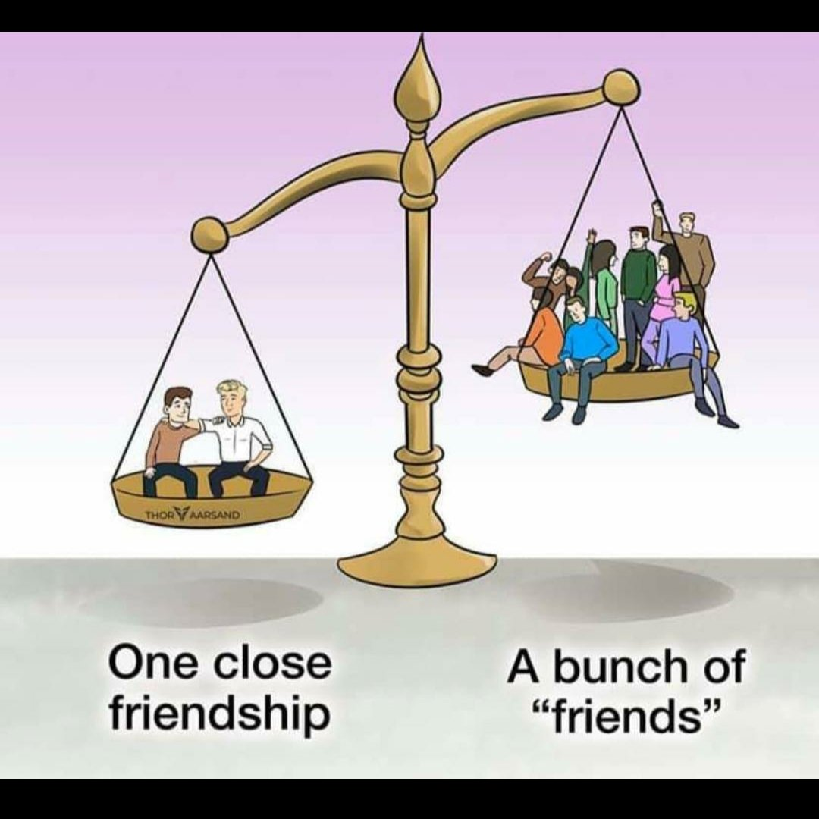
Principles of Biblical friendship
One who has unreliable friends soon comes to ruin, but there is a friend who sticks closer than a brother. (Proverbs 24:18 NIV)
Quality over Quantity
Notes:
1. Selectivity
First is the principle of selectivity. “A man of many companions may come to ruin, but there is a friend who sticks closer than a brother” (Prov. 18:24). This proverb reminds me that everyone cannot and should not be a close friend. Quality trumps quantity, when it comes to friendship. Select your friends wisely and then stick to them.
We should select friendships carefully because wrong friends bring harm.
“Whoever walks with the wise becomes wise, but the companion of fools will suffer harm” (Prov. 13:20).
Character is caught as much as taught, and this is true of character both noble and base. “Make no friendship with a man given to anger, nor go with a wrathful man, lest you learn his ways and entangle yourself in a snare” (Prov. 22:24-25; see also 12:26 and 16:29).

Slide 6
Principles of Biblical friendship
Do not forsake your friend and your father’s friend, and do not go to your brother’s house in the day of your calamity. Better is a neighbor who is near than a brother who is far away” (Prov. 27:10).
Proximity
Notes:
2. Proximity
Relationships gain strength through proximity. Distance makes friendship more difficult. You need friends who live close to you.
“Do not forsake your friend and your father’s friend, and do not go to your brother’s house in the day of your calamity. Better is a neighbor who is near than a brother who is far away” (Prov. 27:10).
The word “neighbor” translates the same Hebrew word as “friend.” This reminds us that friendship involves not only shared time and interests, but also shared space. When friends don’t spend time together, they will inevitably grow distant. As Emerson said, “Go often to the house of thy friend, for weeds choke the unused path."
In order to support others, we have to be aware of what’s going on in their lives. We can’t possibly know what other people’s struggles, concerns, challenges, hopes and dreams are if we don’t make the time to engage in real conversations with them.
“There may be people you know who you really like, but if you don’t spend quality, one-on-one time with them, you’re never going to move from a ‘casual connection’ to something more meaningful,” Dr. Halpin says.
This is my own experience feel free to add your own:
Granted, life may be crazy busy. Still, most of us can probably find more time for friends just by being more intentional about it. For instance, I routinely schedule phone chats with long-distance friends (which often happen while I’m folding clothes or making dinner) and “coffee dates” with local friends. Even if all we can manage is one in-depth conversation every couple months, I’ve found that can still go a long way in maintaining close connections.
It’s not that casual or purely social friendships don’t matter; they do.
The point is that if you don’t also have biblically based friendships, you are missing out. God wants us to experience friendships that inspire and encourage us to persevere and grow. And it’s a two-way street; friendships also give us the opportunity to support and enrich the lives of our friends. I have a plaque in my office that says, “Friends are God’s way of taking care of us.” I totally believe that’s true. We are going to face challenges and trials, make mistakes, fall short and feel discouraged at times. It is our close friendships with others in the faith, along with our foundational relationship with God, that help get us through life’s ups and downs.

Slide 7
Principles of Biblical friendship
“Let your foot be seldom in your neighbor’s house, lest he have his fill of you and hate you” (Prov. 25:17).
Boundaries
Notes:
3. Boundaries
On the other hand, Proverbs also teaches the principle of boundaries. Know when to leave a friend alone. Different people have different capacities for friendship and various friendships have different limitations. Learn when to give your friends space. “Let your foot be seldom in your neighbor’s house, lest he have his fill of you and hate you” (Prov. 25:17).
Benjamin Franklin was on to something when he said, “Guests, like fish, stink after three days.” Don’t wear out your welcome!

Slide 8
Principles of Biblical friendship
“Argue your case with your neighbor himself, and do not reveal another’s secret, lest he who hears you bring shame upon you, and your ill repute have no end” (Prov. 25:9-10)
Respect
Notes:
4. Respect
Along with mutuality, friendships require respect. Respect is the foundation of any good relationship.
One of the main ways we show respect is in how we talk about our friends when they are not around.
“Argue your case with your neighbor himself, and do not reveal another’s secret, lest he who hears you bring shame upon you, and your ill repute have no end” (Prov. 25:9-10).
In other words, don’t expect to keep friends if you talk about them behind their back. Friends know when to speak and when to be silent. “Whoever belittles his neighbor lacks sense, but a man of understanding remains silent” (Prov 11:12; see also 11:9 and 16:28).

Slide 9
Principles of Biblical friendship
Better is open rebuke than hidden love. Faithful are the wounds of a friend; profuse are the kisses of an enemy” (Prov. 27:5-6).
Honesty
Notes:
6. Candor
The sixth principle of friendship, closely related to respect, is candor.
“Better is open rebuke than hidden love. Faithful are the wounds of a friend; profuse are the kisses of an enemy” (Prov. 27:5-6).
As Oscar Wilde said, “A true friend stabs you in the front.”
Find friends who will be honest with you, even if it means wounding you with love. Flattery is a flimsy foundation for friendship (see Prov. 28:23).
True friends will go a step further and offer sincere, loving correction when it’s called for. “This gentle honesty is something that sets true friendships apart from superficial ones,” notes Mary Halpin, a clinical psychologist in Deerfield, Illinois. “A more casual friend probably won’t risk saying something that might upset you. But a real friend will be willing to bring these issues up, not to judge or belittle you, but out of genuine concern.”
Proverbs 27:5-6 tells us, “Open rebuke is better than love carefully concealed. Faithful are the wounds of a friend, but the kisses of an enemy are deceitful.” Godly friends will tell you if you are making a serious mistake in your life—even if it stings a bit. We all have blind spots, and sometimes we need another set of spiritual eyes to help us stay on the right path.
Should we point out every little fault or idiosyncrasy of our friends? No, of course not. Usually, our close friends are willing to overlook our flaws, and that’s something we can be thankful for. However, when what we’re doing is negatively impacting our spiritual lives or the people we love, that’s a different matter. True friends will confront us and urge us to change direction.

Slide 10
Principles of Biblical friendship
Love prospers when a fault is forgiven, but dwelling on it separates close friends.” (Prov. 17;9).
Forgiveness
Notes:
7. Forgiveness
No friendship can last without forgiveness.
“Whoever covers an offense seeks love, but he who repeats a matter separates close friends” (Prov. 17:9).
This teaches us to be generous in extending the gift of forgiveness to our friends, by covering their offenses. “A friendly eye is slow to see small faults,” wrote Shakespeare. True friendship is too valuable to throw away over petty differences.

Slide 11
Principles of Biblical friendship
A friend loves at all times, and a brother is born for adversity” (Prov. 17:17).
Constant
Notes:
8. Constancy
Finally, Proverbs teaches the principle of constancy. “A friend loves at all times, and a brother is born for adversity” (Prov. 17:17).
The heart of friendship is constancy in love. And the greatest test of love is sacrifice. “Greater love has no man than this that he lay down his life for his friends” (John 15:13).
So said the Greatest Friend of all, the Lord Jesus himself, the friend of sinners, the one whose forgiveness never ends, whose love never fails.
Very often, our natural inclination is to stay clear of people who are facing difficult circumstances. Why? “We’re afraid sometimes to enter into others’ pain because we know it’s possible, we might say the wrong thing, or we might not have the right answers. But mostly, I think, we’re afraid of the burden,” writes Christine Hoover in Messy Beautiful Friendship (2017). She calls adversity the “litmus test of friendship” because it asks us to “willingly enter someone else’s pain.”
The second part of Proverbs 17:17 states that “a brother is born for adversity.” True friends are willing to endure discomfort so they can be there for each other when needed.
This might mean being a good listener to someone who needs to talk, praying or fasting about another’s situation, sending notes of encouragement, providing practical help like supplying meals, or simply sitting quietly with a hurting friend who may not want to talk but still doesn’t want to be alone. When we show this kind of support, we can’t help but feel more bonded together.

Slide 12
Principles of Biblical friendship
Romans 12:15
Rejoice with them that do rejoice, and weep with them that weep.
Genuine Happiness for one another
Notes:
9. Genuine happiness for each other’s successes
Romans 12:15 says to “rejoice with those who rejoice, and weep with those who weep.”
Sharing another’s pain isn’t something people typically want to do, but the first half of this verse can be just as unnatural.
Many times, in our dog-eat-dog world, people find themselves competing with friends, sinking to envy if a companion one-ups them.
In stark contrast, godly friends rejoice in each other’s achievements, successes and blessings. Each person wants the other to do well, even if it means being outshined by him or her. Godly friends find true happiness in each other’s happiness, always cheering the other on to do his or her very best.

