Slide 1
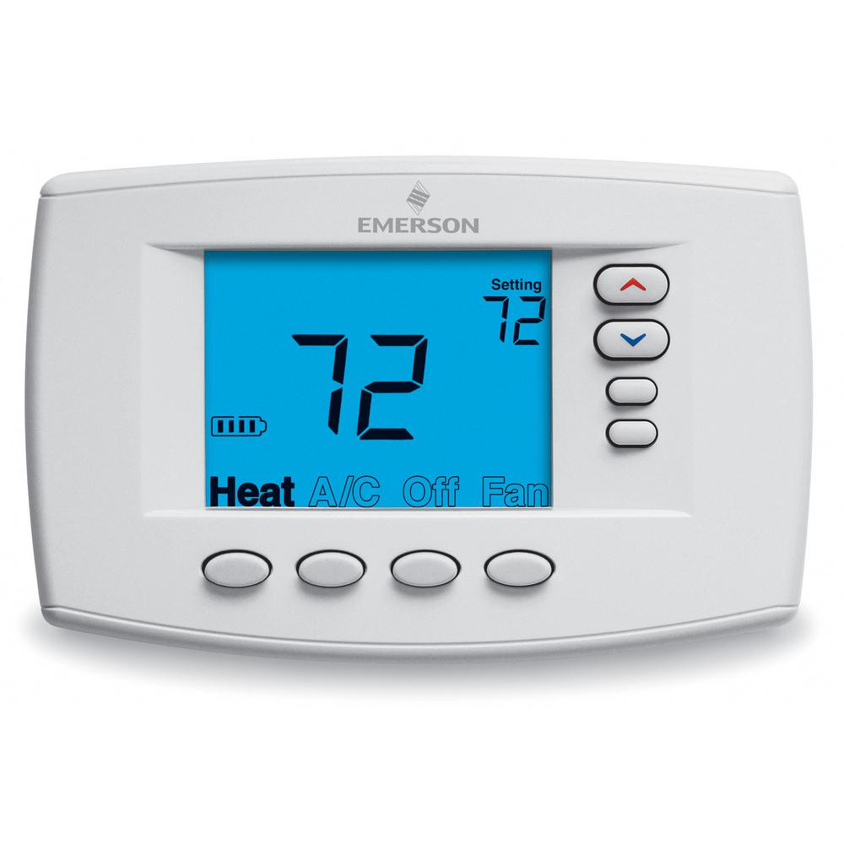
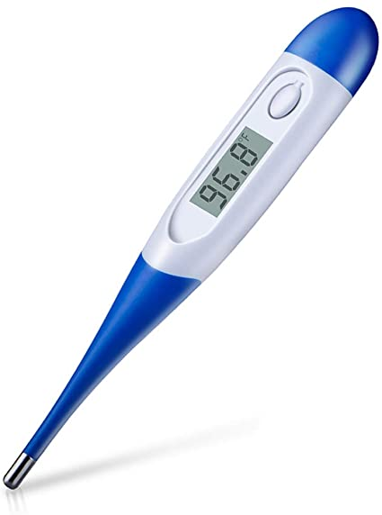
Are you a thermostat or a thermometer?

Slide 2
What is a Thermostat? What is a Thermometer?
Thermostat - a device that automatically regulates temperature, or that activates a device when the temperature reaches a certain point.
Thermometer - an instrument for measuring and indicating temperature
Notes:
A thermometer is like a mirror, it reflects the temperature of its environment. You’ll notice that the language of a thermometer is always influenced by what is going on around it. So when the temperature of a room is hot, the reading is high- if the temperature of the room drops, the reading drops too! Thermometers are in a constant state of change, meaning they can be both “up” and “down” based on its environment.
A thermostat, on the other hand, is used to regulate its environment. A Thermostat is used to maintain a desired temperature! We programme our thermostats to keep our homes at a set temperature. This means when the temperature of our homes drops below this, the thermostat turns the heating on to bring it back up. Likewise, if the temperature of our homes rises above the desired temperature, the thermostat can turn the heating off or turn the air conditioning on to bring it back down. It works by constantly monitoring the environment and whether the temperature gets too hot or too cold, or whether it’s raining or heat waving, it corrects the situation every single time.
The real question is: As a Christian do you reflect the environment or do you want to be the change? Do you conform to your environment or do you set the temperature and make a change? Are you a thermostat or are you a thermometer?
Being an ambassador for Christ isn’t about reacting to the atmosphere, it’s about setting it. Jesus tells us in Matthew 5 that we are the “salt of the earth” and the “light of the world.” We’re designed to change our circumstances, not merely reflect them. So I want you to Think about where you work or where you go to school. Is it a healthy environment or a toxic one? Does it reflect the world’s values or godly values? Are you merely reflecting the culture around you, or are you being intentional for Christ? Are you being salt and light? Are you a thermometer or a thermostat? Think about your home environment. Is it a healthy environment? Is it filled with love, intimacy, trust, care, joy and laughter? Is God in the middle of your home? Is Christ at the center of your family, your marriage? Or have you fallen under the world’s example? Is there bitterness, anger, silence in the home? If our environment is toxic, at home, at work, at school or even in the church, God is calling us to be a thermostat, to change the emotional and spiritual climate in your home.

Slide 3
Why do we sometimes reflect or conform to our environment?
We conform because of unfamiliar surroundings and peer pressure
We conform because we submit to our own desires
We conform out of ignorance
We confirm out of the fear of being labeled
We conform out of a misguided attempt to be relevant
Notes:
We are to transform the world not conform to it. What does conform mean? What is the definition of Conform?
(Receive answers)
To conform means to behave according to the usual standards of behaviour that are expected by a group or society:
When we conform to the world, we are fashioning our lives and conduct by those around us instead of living a life that resembles the life of Christ.
Conforming to the world looks like:
-Fashioning our lives or conduct by the thoughts and opinions of those around us, including those we follow on social media, rather than on what Scripture says.
-Trying to fit in with the behaviors or customs of the world at work, in relationships, or even in the church.
What are some reasons why we may conform?
(Receive Answers)
1. Unfamiliar surroundings and peer pressure - are difficult for all of us and it can make us act out of character and do things we said we would never do. Think about when you are put in with new people and a new environment and all you want to do is fit in and be accepted. Many teenagers and adults will cave to the pressure simply because the environment they are in puts pressure on them to conform to their ways.
2. Indulge our own desires – This is probably the most frequent reason. We have sinful desires and sometimes we give in to them. Let’s remember – We never have to give in to temptation. God will always provide a way out if we will take it (1 Corinthians 10:13).
3. Ignorance of God’s Word – Sometimes believers live like the world in one or more areas simply because they don’t know God’s standard. Yet God calls us to “not conform to the evil desires you had when you lived in ignorance,” but to be holy in all we do (1 Peter 1:13-15). Thankfully we can learn since we have full access to His Word!
4. Fear of being “labeled” – Sometimes believers worry more about what the world will think of us than what God will think of us. We don’t want to be considered a “bigot” or “self-righteous.” We don’t want to be different or stand out in a crowd. So we compromise to fit in.
5. Misguided attempt to be relevant – I’ve heard and seen Christians – even Christian leaders – dress and speak in questionable ways in an attempt to connect with the culture. If our speech or dress or behavior shocks or offends even a handful of Christians in the room, we should reconsider. Jesus and His message of salvation are always relevant. We don’t have to compromise to share them.

Slide 4
How to not conform to this world?
And be not conformed to this world: but be you transformed by the renewing of your mind, that ye may prove what is that good, and acceptable, and perfect, will of God. Rom. 12:2 KJV
Notes:
How can we as Christians ensure that we do not conform to this world?
(Ask someone to read key text)
But we are not to conform but transform and Transformation can only come when we change the way we think. What is conceived in the mind, is carried out by the body. Romans 12:2 says we have to renew our minds.

Slide 5
Renew your mind
Filling your mind
Guarding your mind
Framing your mind
Notes:
What Does it mean to renew your mind?
1. FILLING YOUR MIND
The first step toward renewing your mind is the steady intake of God’s Word. Peter calls Christians to “desire the pure milk of the word, so that you may grow up into your salvation” (1 Pet. 2:2).
This is an ongoing process for every believer throughout our Christian lives.
We are to not just read the Bible; we must make sure to meditate on it. In addition to reading and meditating on Scripture, you can listening and watching things that feed us spiritually.
2. GUARDING YOUR MIND
If filling your mind refers to what you take in, guarding your mind refers to what you keep out. Which can be a challenge. We live in an age of social media and entertainment.
The information we let in, the thoughts we entertain, the ideas we foster, all can do much good—or much evil.
Yet, as Christians, we have our marching orders. Casting down imaginations, and every high thing that exalteth itself against the knowledge of God, and bringing into captivity every thought to the obedience of Christ;(see 2 Cor. 10:5).
We guard our minds not only by what we keep out, but by what we choose to dwell on. What we determine to think on is, in many ways, determinative for our spiritual lives.
That is why the apostle Paul says“Finally, brothers and sisters, whatever is true, whatever is honorable, whatever is just, whatever is pure, whatever is lovely, whatever is commendable— if there is any moral excellence and if there is anything praiseworthy—dwell on these things” (Phil. 4:8).
3. FRAMING YOUR MIND
Lastly, not only are we to fill our minds and guard them, we are to frame them as well. Your frame of mind is your Mental attitude and outlook on the world.
We can only do this through scriptural intake of the word of God. The intake of the Word reframes our outlook and gives us a biblical foundation to engage life and view the world, and to process all of life from a Christian perspective. When we have a personal relationship with God and we spend time in his word we as Christians have a different outlook or perspective of the world.

Slide 6
Realize you are a new creation
“Therefore, if anyone is in Christ, he is a new creation. (2 Cor 5:17 ESV)
Notes:
Realize what and who you are when you accept Christ:
Our lives are no longer worldly; they are now spiritual. We did not inherit the new nature or decide to re-create ourselves anew. God made us new. God didn’t simply clean up our old nature; He created something entirely fresh and unique. The new creation is completely new.

Slide 7
Crucify the flesh and live by the spirit
Gal. 5:24-25 - And those who are Christ’s have crucified the flesh with its passions and desires. If we live in the Spirit, let us also walk in the Spirit.
Notes:
Final point on how we do we not conform to the world.
What does it mean to crucify the flesh?
Crucify the flesh describes a deliberate putting to death of the old sin nature. Paul’s instruction was inspired by Jesus Christ Himself, who said, “If anyone wants to follow after me, let him deny himself, take up his cross, and follow me” (Mark 8:34, CSB). Believers are to take their old sin nature and, figuratively speaking, nail it to the cross. We crucify the flesh through repentance of sin—by turning our backs on the old way of life, by saying no to selfish and sinful passions, and by denying the flesh: “Do not let any part of your body become an instrument of evil to serve sin. Instead, give yourselves completely to God, for you were dead, but now you have new life. So use your whole body as an instrument to do what is right for the glory of God” (Romans 6:13, NLT).
What does it mean to live by the spirit?
(Receive answers)
-Holy Spirit is a gift/we only need to ask
-We can do nothing in and of ourselves its only through the power of the Holy Spirit in us
John 14:26 ESV But the Helper, the Holy Spirit, whom the Father will send in my name, he will teach you all things and bring to your remembrance all that I have said to you.
Romans 8:26 ESV Likewise the Spirit helps us in our weakness. For we do not know what to pray for as we ought, but the Spirit himself intercedes for us with groanings too deep for words.
Galatians 5:22-23 ESV But the fruit of the Spirit is love, joy, peace, patience, kindness, goodness, faithfulness, gentleness, self-control; against such things there is no law.
How often do we crucify the flesh and live by the Spirit?
Not conforming to this world may seem difficult at times. But by being intentional in these things—living as a new creation, renewing our minds, feeding ourselves good fruit, crucifying our flesh, and forming godly habits around spiritual disciplines—we are able to guard ourselves against the world.

Slide 8
Dare to be a Daniel
He Made up his mind ahead of time
He was more concerned with Gods opinion of him rather than the world’s.
He was faithful and trusted God with the outcome
Notes:
Daniel was placed in a situation where he had to choose to conform or not.
How did he respond?
(Receive answers)
Daniel was determined to do the will of God and made a decision ahead of time not to defile himself Dan 1:8 But Daniel purposed in his heart that he would not defile himself with the portion of the king’s delicacies, nor with the wine which he drank; therefore he requested of the chief of the eunuchs that he might not defile himself.
But Daniel made up his mind that he would not defile himself..." (v8). What a contrast! Daniel knew that the food at the king's "training table" was contrary to the God’s Law. Not only were some of those foods expressly forbidden to Jews by the Scriptures, but the king's food was probably dedicated to heathen idols. Eating and drinking the king's choice food would have involved Daniel in defiling pagan religious practices. So Daniel refused to compromise and disobey the Word of God. He knew that God doesn’t "water down His Word" because of uncomfortable or tough or "sticky" situations. God is pleased when we dare to be Daniels! Although Daniel adjusted and accommodated to his new environment, he didn’t conform to Babylon. But Daniel didn’t compromise in matters of faith. Babylon's goals did not become Daniel's goals. Babylon's glories did not become Daniel's glories. Babylon's gods did not become Daniel's gods. Daniel didn’t disobey the Word of God. He didn’t compromise in his faith or conform to this world. Daniel dared to be faithful. (https://www.growingchristians.org/devotions/dare-to-be-a-Daniel)

Slide 9
How do we be effective agents of change for god?
Notes:
(Receive answers)

Slide 10
Start with yourself
Notes:
(1) We need to experience a personal transformation
(2) The life you live is the most effective form of evangelism
What are qualities of an effective agent of change?
(Receive answers from audience)
(https://churchleaders.com/pastors/pastor-articles/299588-7-characteristics-effecitve-change-agent-leaders-ron-edmondson.html)
Flexible
It doesn’t have to be their design. They simply want progress toward the overall vision. These change agents are never stubborn on matters that seem to have no vision-altering value. They navigate toward a solution, letting others have “their” way. Everyone walks away feeling as though they have won.
Courageous
Change agent leaders are willing to receive criticism and still move forward. They know how to filter through what is valid criticism—worth hearing—and what’s simply a venting of personal interest. They unwaveringly push through the junk that clouds progress.
Relational
Good change agent leaders value the opinions of other people and work hard to gain trust. They know ultimate change can’t happen without human capital and they are constantly investing in relationships. Networking is one of a change agents greatest tools.
Strategic
A change agent leader realizes there are steps to take, and they carefully choose the timing of when to take them. They almost have a keen sense of discernment when it comes to knowing when to pull the trigger, when to wait and when to pull the plug completely.
Creative
Good change agents are able to see paths to success others can’t yet see. I need to be honest here and say I’d rather be strategic than creative. There are some who can always find a way to make their ideas work, but it comes at the expense of others. But, change often happens because someone chose to be creative. Effective change is one of the best forms of art in the field of leadership. This takes creativity.
Intentional
Change agent leaders make change for a specific purpose. They never waste a change. They know that every change has the potential to make or break a team, and they work diligently to bring the best results.
Thorough
A good change agent follows through on commitments made and sees the change to fruition. They don’t give up until the post evaluation is complete and the lessons of change have been learned.

Slide 11
Have a vision
Proverbs 29:18 Where there is no vision, the people perish: but he that keepeth the law, happy is he.
Notes:
What is the underlying objective of the church?
Whether you want to be an agent of change at work, at home or at church you should have a plan, objectives for you to accomplish that. The church should have a vision for how we should accomplish our objective or mission. Our mission is found in Matthew 28:19-20 “Go therefore and make disciples of all the nations, baptizing them in the name of the Father and of the Son and of the Holy Spirit, “teaching them to observe all things that I have commanded you; and lo, I am with you always, even to the end of the age.” It is essential to note that a clear vision does not mean that there is one way to do things; in fact, it is essential to tap into the strengths of the people you work with and help them see that there are many ways to work toward a common purpose.
Does a thermostat, a change agent of God have to be in a position of authority to be effective or to bring about change?
A “change agent” does not have to be the person in authority, but they do however have to have a clear vision and be able to communicate that clearly with others. It is essential to note that a clear vision does not mean that there is one way to do things; in fact, it is essential to tap into the strengths of the people you work with and help them see that there are many ways to work toward a common purpose.

Slide 12
Know your spiritual gifts
Romans 12:4-5 For as in one body we have many members, and the members do not all have the same function, so we, though many, are one body in Christ, and individually members one of another.
Notes:
Why do you think knowing your spiritual gift is important when being an agent of change?
1. Knowing your spiritual gift helps you understand God’s will for your life.
Spiritual gifts are tools given by God for doing the work of the ministry. Different people are given different gifts to handle different tasks. Understanding your gift will enable you to make decisions as to where to serve God, and even perhaps where you are called to make a change. Knowing your spiritual gift helps you know what God has not called you to do. You can readily use your gift and the gift of others to implement change.

Slide 13
The three P’s
Galatians 6:9 And let us not grow weary of doing good, for in due season we will reap, if we do not give up.
Notes:
When being an agent of change why are these three P’s important?
Receive answers
Positivity - Positivity is a practice. It’s a movement toward what you desire and aspire to change. You cultivate it for yourself through the language you use, the habits or behaviors you exhibit, the interactions and relationships that you have, and how you invest your time.
Patient – Change doesn’t happen overnight. We need to pray to God for the capacity to accept or tolerate delay, problems, or suffering without becoming annoyed or anxious.
Persistent – When brining about change there will be obstacles and difficulties that you face. Pray to God to the that you will stay committed and persistent!

Slide 14
What are some challenges that a change agent may face?
Resistance to change
Discouragement
Time and Money
Notes:
Resistance – Why do you think people resist change?
-People avoid change because of the habits they have developed over a lifetime.
-People may think it is just easier to just keep things ‘as is’.
-Brining about change may require work
How do we overcome resistance?
-Building a relationship with the people whom the change will impact
-Educate and communicate how the change will be beneficial to them
-Listen first, talk second
Discouragement
Trust in God -Romans 8:28, “And we know that God causes everything to work together for the good of those who love God and are called according to his purpose for them.”
How do you overcome being discouraged? Lean into a positive friend. A positive friend is someone who will listen to what has gotten you down and be able to encourage you through it. Sometimes the encouragement comes from their presence alone. Sometimes it comes from something they say. Solomon wrote in Proverbs 12:25, “Worry weighs a person down; an encouraging word cheers a person up.” One of the quickest ways to overcome discouragement is to reach out to someone who can lift us up.
What do we do when we are faced with the challenge of no Time or Money - Philippians 4:19 ESV And my God will supply every need of yours according to his riches in glory in Christ Jesus. God will provide the means for our goals and vision. IF he is at the center of your plan it cannot fail. We to have to do our part. We find time for the things that are important to us! We are called to be good Stewards of time and may need to prioritize our schedule to ensure that we have time set aside to be active in God’s work.
How should an agent of change respond to criticism?
You need to be able to withstand criticism. – Change invites pushback. Change changes things. Change is uncomfortable and people will tell you the degree of discomfort they are feeling. Sometimes in passionate…even mean ways. You’ll feel unpopular at times.

Slide 15
Questions?
Notes:
As Change Agents, we are to be the catalyst that produces directional change – ultimately leading the Church to be a stronger and more efficient end-time institution. I pray that God makes all of us thermostat Christians who will stop reflecting the temperature of this world and who are more concerned about pleasing God, as we set the temperature of Godliness in our family, church, work place and community.

