Slide 1
WISDUMB – A Biblical Guide to make better decisions
www.digitaldisciple.org
Notes:
The purpose of this presentation is to help others to make wise decisions in life by providing biblical principles. With each slide allow the audience to respond to each question before revealing answers.
Key Text - If any of you lacks wisdom, you should ask God, who gives generously to all without finding fault, and it will be given to you. James 1:5 (NIV)
Opening Prayer
Song Service/Praise and worship
Key Text
Welcome
Bible Base Game or Trivia
Presentation
Closing Thoughts – (Ask you pastor or elder to give closing thoughts or recap key points you want the audience to remember)
Closing Song
Closing Prayer

Slide 2
Why is it important for us to make wise decisions?
From our youth, the decision we make affect our lives and shape our futures
The decisions you make can affect those around you
We save time and make better use of our resources
Notes:
Ask the question on the slide and allow time for the audience to respond. After they have responded reveal the answers on the slide.

Slide 3
What is Wisdom and how do we obtain it?
Definition - the ability to use your knowledge and experience to make good decisions and judgments.
Pro 9:10 (NLT) Fear of the LORD is the foundation of wisdom. Knowledge of the Holy One results in good judgment.
James 1:5 (ESV) If any of you lacks wisdom, let him ask God, who gives generously to all without reproach, and it will be given him.
Notes:
Ask the question on the slide and allow time for the audience to respond. After they have responded reveal the answers on the slide.
Ask the question - What does it mean to fear the Lord? Fearing the Lord means to be in awe of his holiness, to give him complete reverence and to honor him as the God of great glory, majesty, purity and power.
Say - We can put decisions into two types of categories moral/non-moral decisions. When it comes to moral decisions, decisions where we are concerned with principles of right and wrong behavior, the bible should be our reference and sometimes the answer can be explicitly seen. Some examples of moral decisions where the bible gives clear guidance include (1) Should I steal (Ex. 20:15) ? (2) Whether or not I should have sex before marriage (1 Cor 6:18-20)? And (3) What should I do if a brother sins against me (Matt. 18:15)? Sometimes there isn’t explicit guidance on certain issues but you can find underlying principles that can help you decide. For example, should I take drugs? (1 Corinthians 3:16-17)

Slide 4
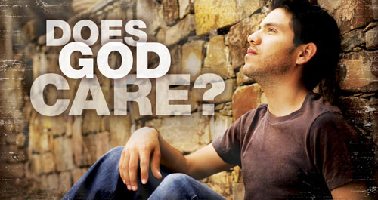
Does God care about the non-moral decisions we make?
“Do not be anxious about anything. But in every situation, by prayer and petition, with thanksgiving, present your requests to God” Philippians 4:6 (NIV).
Notes:
Say – What about decisions where there are not direct answers in the bible or if there are multiple acceptable routes that can be taken? The Bible doesn’t even give specific guidance on huge, life-shaping decisions like should I marry this person? Should I give more or save for retirement? Should we adopt a child? Should I pursue a different career? Should we homeschool? Should I pursue chemo or try an alternative cancer treatment? Should we buy this home or a less expensive one? Which college should I attend? Is it time to put my elderly parent in a nursing home? Should I go to the mission field? Should I separate from my spouse while we work on these very painful issues?
Ask the question on the slide and allow time for the audience to respond. After they have responded reveal the answers on the slide.
These kinds of decisions tend to have multiple acceptable options within the scope of God’s revealed moral will, his commandments. Yet he cares deeply about the details and course of our lives.
Proverbs 3:5-6 Trust in the LORD with all thine heart; and lean not unto thine own understanding. In all thy ways acknowledge him, and he shall direct thy paths. God cares about every aspect of our lives and He his willing to help us make the decision that is best for him if we ask Him.

Slide 5
What are some factors that can influence us when making decisions?
Some factors include:
Our upbringing, values and beliefs
Friends and family
Our circumstances
Our emotions
Experience
Romans 14:12 - So then, each of us will give an account of ourselves to God.
Notes:
Ask the question on the slide and allow time for the audience to respond. After they have responded reveal the answers on the slide.
Be aware of the things that influence your decisions because they may not always be positive influences.
For Example, Daniel Shadrach and Abednego were taken into Babylonian captivity. The king assigned them a daily ration of food and wine from his own kitchens. But Daniel was determined not to defile himself by eating the food and wine given to them by the king. He asked the chief of staff for permission not to eat these unacceptable foods. He asked for him and his friends to be tested for ten days on a diet of vegetables and water and At the end of the ten days, he asked to be compared to the other young men who are eating the king’s food. At the end of the ten days, Daniel and his three friends looked healthier and better nourished than the young men who had been eating the food assigned by the king. What influenced their decisions in captivity? (Allow time for the audience to respond)
Daniel and his friends made good decisions despite of their circumstances because of their upbringing values and beliefs.
We all may have different factors that may influence us whether positive or negative but at the end of the day we will have to be accountable for the decisions that we make. When Adam and Eve made the decision to eat the fruit, they casted blame. Adam told God the woman you gave me the fruit to eat and Eve said the serpent deceived me. Romans 14:12 says So then every one of us shall give account of himself to God. – We are responsible and will be held accountable for the decisions we make

Slide 6
Get into the word of God Does the Bible have anything to say about our decision? Is your specific issue discussed? Can any insight be gained about our circumstance?
Notes:
Say – So just to recap what we’ve discussed so far, when faced with a decision ask yourself Does the Bible have anything to say about our decision? . Is your specific issue discussed? Can any insight be gained about our circumstance? If there is, follow the guidance that is provided. Is our possible decision consistent with God’s word? The decision that you make should always be in accordance with the word of God.

Slide 7
When you are faced with a choice what are some things you might consider or do to help you decide?
- Pray
- Think about consequences
- Refer to Gods word
- Consider the pros and cons
- Ask for Advice
- Ensure you know all the facts
and options
Notes:
Ask the question on the slide and allow time for the audience to respond. After they have responded reveal the answers on the slide.

Slide 8
Biblical Guideline – Pray for Guidance
Psalm 32:8 (NIV) I will instruct you and teach you in the way you should go; I will counsel you with my eye upon you.
Isaiah 30:21 (ESV) And your ears shall hear a word behind you, saying, “This is the way, walk in it,” when you turn to the right or when you turn to the left.
Proverbs 3:6 (ESV) In all your ways acknowledge him, and he will make straight your paths.
Notes:
Say - The first thing we should always do is pray for guidance.
Read and share the scriptures on the slide and discuss what God promises in each one.

Slide 9
Proverbs 11:14 - Where there is no guidance the people fall, but in an abundance of counselors there is victory.
Proverbs 18:1 - He who separates himself seeks his own desire. He quarrels against all sound wisdom.
Proverbs 18:2- A fool does not delight in understanding, but only in revealing his own mind
Proverbs 15:22 - Without counsel plans fail, but with many advisers they succeed.
Biblical Guideline – Seek Advice
Notes:
Say – We can also seek advice when we have an important decision to make.
Read and share the scriptures on the slide and discuss what each one is saying.

Slide 10
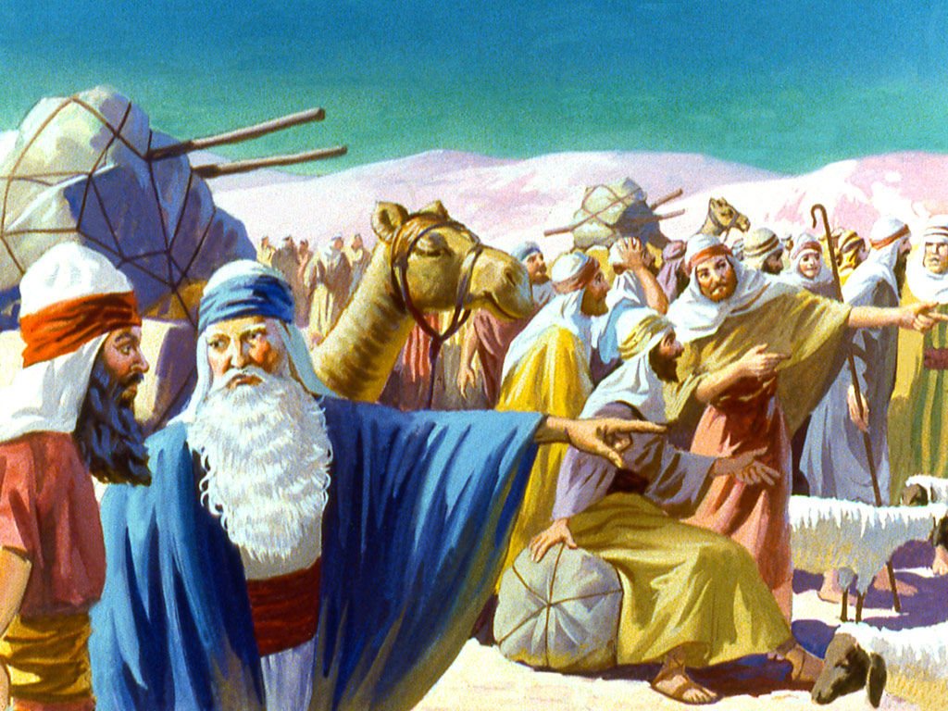
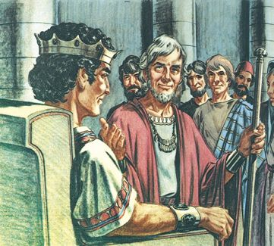
How do you determine who is the appropriate person to seek advice from when making a decision?
Exodus 18 – Moses takes advice from Jethro
King Rehoboam listened to the advice from his friends rather than his advisors 1 Kings 12
Notes:
Ask the question on the slide and allow time for the audience to respond. After they have responded reveal the answers on the slide.
We should seek advice from persons with experience/knowledgeable, persons with good character –an Individual who would not give any advice contrary to God’s word.
Give a brief summary in your own words of the story of Moses and when he took advice from Jethro.
Say – By listening to the wise advice Jethro gave Moses was better able to lead the people of Israel and resolve the disputes among them
Give a brief summary in your own words of the story of King Rehoboam (1Kings 12:1-20)
As a result of taking advice from his friends rather than the elders, Israel rejected not only Rehoboam, but also the entire dynasty of David. They rejected the descendants of Israel’s greatest king. From this point on in the history of Israel, the name “Israel” referred to the ten northern tribes and the name “Judah” referred to the southern tribes of Benjamin and Judah. There was a long-standing tension between the ten northern tribes and the combined group of Judah and Benjamin because the King Rehoboam’s decision.

Slide 11
Biblical Guideline - Be informed. Do I have all the facts?
Proverbs 18:13 (NKJV)
He who answers a matter before he hears it, It is folly and shame to him.
Proverbs 13:16 (NLT)
Wise people think before they act; fools don’t—and even brag about their foolishness.
Notes:
Read the slide
Say - He who answers a matter before he hears it - It is common to give a quick, impulsive answer to questions and problems. We respond without thinking, or without hearing the full story, sometimes more interested in what we hope to say than what the matter before us really is.
Say - A wise man or woman not only has knowledge, but they act with it. Wisdom is more than in their mind, it is in their life. We should carefully consider and think about a decision after having all the facts at hand. A man like this will not make many mistakes. A fool jumps in without considering the facts.

Slide 12
Biblical Guideline - Be Patient
1 Samuel 13:13 (NIV) "You acted foolishly," Samuel said. "You have not kept the command the LORD your God gave you; if you had, he would have established your kingdom over Israel for all time.
Notes:
Say - Samuel 13:1-15, we see how one bad decision altered Saul's destiny. The sequence of events is fairly straightforward:
1. Saul's first born son Jonathan leads a successful attack against the Philistines (v3-4).
2. In response, the Philistines come roaring back with a massive force, assembling at Micmash, ready to fight Israel (v5).
3. Meanwhile, Saul remains in Gilgal with his army, waiting for Samuel. Samuel had told Saul to wait seven days for him in Gilgal so that Samuel could offer burnt offerings and fellowship offerings on his behalf (see 1 Samuel 10:8).
4. By the 7th day, with his troops beginning to scatter (v8) and the Philistines assembling nearby (v11), Saul gets antsy, decides not to wait anymore for Samuel and offers the sacrifices himself (v9), something only a priest like Samuel was authorized to do.
5. Just as Saul finishes making the burnt offering, Samuel arrives (v10). Samuel rebukes Saul for not waiting for Samuel to offer the sacrifices (v13). The impact of Saul's decision was huge: if Saul had waited for Samuel and let Samuel offer the sacrifices, God would have established Saul's kingdom for all time (v13). But because Saul disobeyed God by offering the sacrifices himself, Saul's kingdom would not endure and someone else -- "a man after God's own heart" (v14) -- would eventually take Saul's place on the throne.
It is important to be patient when making important decisions.

Slide 13
Biblical Guideline - Consider the consequences and the cost
Gen 39:9 (NKJV)“There is no one greater in this house than I, nor has he kept back anything from me but you, because you are his wife. How then can I do this great wickedness, and sin against God?”
Notes:
Read the verse on the slide and ask - What consequences did Joseph considered? (Allow time for the audience to respond)
Joseph even in this difficult situation is thinking thoroughly about the consequences of making a decision.
He’s not only thinking about the spiritual consequence but also social consequences and the possibility of losing his position. When making a decision we should consider the consequences, what it will cost as and benefits as well.

Slide 14
Biblical Guideline - Emotions should not guide your decision making
Heb 11:24-26 (NLT) It was by faith that Moses, when he grew up, refused to be called the son of Pharaoh’s daughter.
He chose to share the oppression of God’s people instead of enjoying the fleeting pleasures of sin.
He thought it was better to suffer for the sake of Christ than to own the treasures of Egypt, for he was looking ahead to his great reward.
Notes:
Emotions can cloud our judgment and influence our decisions. Feelings are not facts, we should live by faith and not by feelings. For example, when you are with your boyfriend/girlfriend there may be times when you are tempted, and you may feel the desire to have sex. Make you decision based on your faith and not by your feelings. It is God’s will that we have sex in the confines of a martial relationship. In Genesis 20:2, 3, 11, Abraham lied to Abimelech about Sarah because he was afraid of losing his life. David let the emotion of lust lead him into sin by committing adultery with Bathsheba (2 Samuel 2). Let’s ask the Holy Spirit to help us make Godly decision despite how we may feel or the emotions that we may have.
Read and share the scripture on the slide and say – Here we say Moses making a life changing decision by faith. He left the luxury and comfort of the palace, he left the title of Prince and he chose to suffer for Christ. He valued the great reward ahead that Christ would give him over the treasurers of Egypt. Sometimes when we make decisions for Go it won’t always be easy. Like Moses, we may suffer, but you can be sure that it will all be worth it and God will be with you every step of the way!

Slide 15
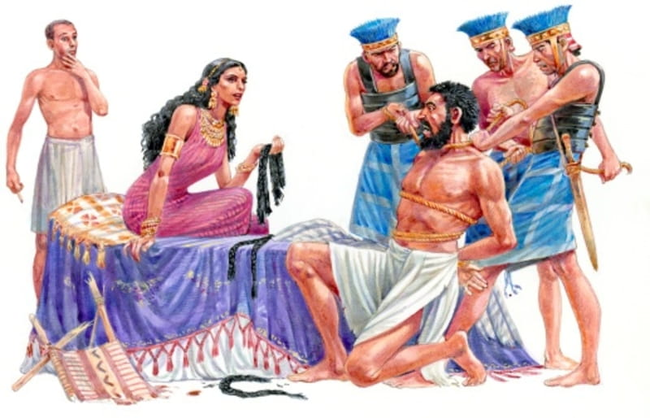
Biblical Guideline - Don’t put yourself in the position to make bad decisions
Judges 14:1 (NKJV) - Now Samson went down to Timnah, and saw a woman in Timnah of the daughters of the Philistines.
Notes:
Read and share the scripture on the slide and say -Samson had no business going to Timnath to look at the daughters of the Philistines. Timnath was only a few miles away from where Samson and his parents lived. It would have been an easy walk, but it was enemy territory. Samson placed himself in positions were he was tempted and it led him to not only make poor decisions but also to his death. As Christians we should putting ourselves in situations that will lead to poor decision making.

Slide 16
What should I do if I make a dumb decision?
Proverbs 26:11-12 Like a dog that returns to its vomit, a fool does the same foolish things again and again. People who think they are wise when they are not are worse than fools.
2 Peter 2:22 Of them the proverbs are true: “A dog returns to its vomit,” and, “A sow that is washed returns to her wallowing in the mud.”
Proverbs 24:16 For the righteous falls seven times and rises again, but the wicked stumble in times of calamity.
Ask for forgiveness
Learn from your decisions
Rise again and move forward
Notes:
Ask the question on the slide and allow audience to respond. Read and share the scriptures on the slide and discuss what each one is saying.

Slide 17
How should we treat persons who have made poor decisions in the past?
Forgive as God forgives you
Discipline in love
Rejoice and welcome them back into the fold
Notes:
Ask the question on the slide and allow time for the audience to respond. After they have responded reveal the answers on the slide.
Say - When we have sinned, we must recognize it and repent. God’s forgiveness doesn’t save us from the consequences of our conduct, but if we’ve abandoned the behavior and are willing to accept the consequences, God will still use us. God forgives and loves embraces. Like God forgives us for making poor decisions we should also remember that we should also forgive others.

Slide 18
Thank you!

